Slide 1
WP3
Online test amplification
Xavier Devroey & Andy Zaidman Brussels, February 6th, 2020

Slide 2
Tasks in WP3
T3.1: Modern logging practices
T3.2: State-of-the-art anomaly replication approach benchmarking
T3.3: Test amplification for anomaly replication
T3.4: Test amplification for common behaviors
T3.5: Strategies for speeding-up runtime amplification

Slide 3
T3.1
Modern logging practices

Slide 4
Modern logging practices
Literature review on logging
Interviews
Survey on state-of-the-practice in logging
STAMP use case providers (often multiple people per company)
29 non-STAMP survey respondents
T3.1
T3.2
T3.3
T3.4
T3.5

Slide 5
Modern logging practices (2)
Main take-aways:
No common logging practice
Logs from production environment not always available
STAMP partners: issue tracker is central knowledge base
T3.1
T3.2
T3.3
T3.4
T3.5

Slide 6
Modern logging practices (2)
Main take-aways:
No common logging practice
Logs from production environment not always available
STAMP partners: issue tracker is central knowledge base
Stack traces
T3.1
T3.2
T3.3
T3.4
T3.5

Slide 7
T3.2
State-of-the-art anomaly replication approach benchmarking

Slide 8
State-of-the-art anomaly replication approach benchmarking
Creation of JCrashPack (200 crashes from open-source + STAMP partners)
Creating of ExRunner A tool for experimentation with crash reproduction.
Research agenda for crash reproduction →12 challenges → 3 research directions
Context matters → seeding (T3.3)
Stack trace preprocessing → preprocessor for crash reproduction (T3.2)
Guided search → refined fitness function (T3.3)
T3.1
T3.2
T3.3
T3.4
T3.5

Slide 9
T3.3
Test amplification for anomaly replication

Slide 10
STAMP crash + generated test (OW2)
Exception in thread "main" java.lang.ArrayIndexOutOfBoundsException: -1 at org.sat4j.core.Vec.get(Vec.java:239) at org.sat4j.pb.constraints.pb.InternalMapPBStructure.get([…].java:102) at org.sat4j.pb.constraints.pb.ConflictMap.isImplyingLiteral([…].java:613) at org.sat4j.pb.constraints.pb.ConflictMap.isAssertive(ConflictMap.java:575) at org.sat4j.pb.core.PBSolverCP.analyzeCP(PBSolverCP.java:141) at org.sat4j.pb.core.PBSolverCP.analyze(PBSolverCP.java:129) at org.sat4j.minisat.core.Solver.search(Solver.java:1321) at org.sat4j.minisat.core.Solver.isSatisfiable(Solver.java:1821) at org.sat4j.tools.SolverDecorator.isSatisfiable(SolverDecorator.java:115) at org.sat4j.pb.PseudoOptDecorator.admitABetterSolution([…].java:179) at org.sat4j.pb.PseudoOptDecorator.admitABetterSolution([…].java:172) at org.sat4j.OptimizationMode.solve(OptimizationMode.java:121) at org.sat4j.AbstractLauncher.solve(AbstractLauncher.java:318) at org.sat4j.AbstractLauncher.run(AbstractLauncher.java:257) at org.sat4j.pb.LanceurPseudo2007.main(LanceurPseudo2007.java:97)
@Test(timeout = 4000) public void test0() throws Throwable { Lits lits0 = new Lits(); IDataStructurePB iDataStructurePB0 = […].TAUTOLOGY; WatchPbLongCP watchPbLongCP0 =
MinWatchPbLongCP.normalizedWatchPbNew(lits0,
iDataStructurePB0); ConflictMapClause conflictMapClause0 =
new ConflictMapClause(watchPbLongCP0, 0, false); VecInt[] vecIntArray0 = new VecInt[9]; VecInt vecInt0 = new VecInt(1799, 1); vecIntArray0[1] = vecInt0; conflictMapClause0.byLevel = vecIntArray0; // Undeclared exception! try { conflictMapClause0.isAssertive(0); fail("Expecting exception: ArrayIndexOutOfBoundsException"); } catch(ArrayIndexOutOfBoundsException e) { // // -1 // verifyException("org.sat4j.core.Vec", e); } }
Crash
Generated test

Slide 11
Test amplification for anomaly replication
EvoCrash reimplemented as the modular Botsing framework
Test + model seeding
Refined fitness function
More crash replications
Easier to work with generated tests
Faster replication
T3.1
T3.2
T3.3
T3.4
T3.5

Slide 12

Traditional Botsing approach (no seeding)
a()
b()
e()
a()
b()
e()
a()
b()
e()
a()
d()
e()
a()
b()
e()
c()
e()
c()
e()
Exception:
at x(…)
at y(…)
at e(…)
c()
a()
b()
e()
e()
c()
d()
e()
c()
d()
e()
c()
a()
b()
e()
Exception:
at x(…)
at y(…)
at e(…)
c()
e()
c()
d()
e()
c()
e()
c()
d()
e()
c()
d()
e()
a()
e()
a()
e()
c()
d()
e()
c()
b()
e()
c()
b()
e()
e()
c()
d()
e()
c()
d()
e()
Stack trace
Random initial test suite
Evolutionary search
Crash reproducing test case

Slide 13
Test seeding
Exception:
at x(…)
at y(…)
at e(…)
a()
b()
e()
a()
b()
e()
c()
a()
b()
e()
e()
e()
c()
a()
c()
c()
e()
c()
d()
e()
c()
e()
e()
c()
d()
a()
Stack trace
c()
d()
e()
c()
c()
e()
e()
a()
c()
Random initial test suite
b()
a()
e()
c()
c()
Existing tests subset
Existing tests

Slide 14
Model seeding
Exception:
at x(…)
at y(…)
at e(…)
a()
b()
e()
a()
b()
e()
c()
a()
b()
e()
e()
c()
b()
a()
e()
c()
e()
c()
d()
e()
c()
e()
c()
d()
e()
Stack trace
c()
d()
e()
c()
d()
e()
a()
e()
Random initial test suite
c()
e()
d()
b()
a()
Model-driven initial test suite
Model of production code + existing test code

Slide 15
How did we apply T3.3 @ use case providers?
ExeComs and Workshops
Visiting partners
Tellu, Atos
Online calls
Activeeon, Xwiki, OW2, Tellu, Atos, Engineering
GitHub issues for development and support
Tutorial
https://github.com/STAMP-project/botsing-demo
Tracking of results + feedback from partners
https://github.com/STAMP-project/botsing-usecases-output
Including XWiki crashes in JCrashPack and feedback from Xwiki developers
https://jira.xwiki.org/browse/IRCBOT-4?jql=text%20~%20%22botsing%22

Slide 16
T3.4
Test amplification for common behaviors

Slide 17
Test amplification for common behaviors
EvoSuite + model seeding → new RAMP tool
Test case generation using call site information (using code instrumentation)
Enable construction of complex objects
Use common method sequences
Better understandable tests
Focus on common/uncommon behavior
T3.1
T3.2
T3.3
T3.4
T3.5

Slide 18
Test case generation using call site information

Slide 19
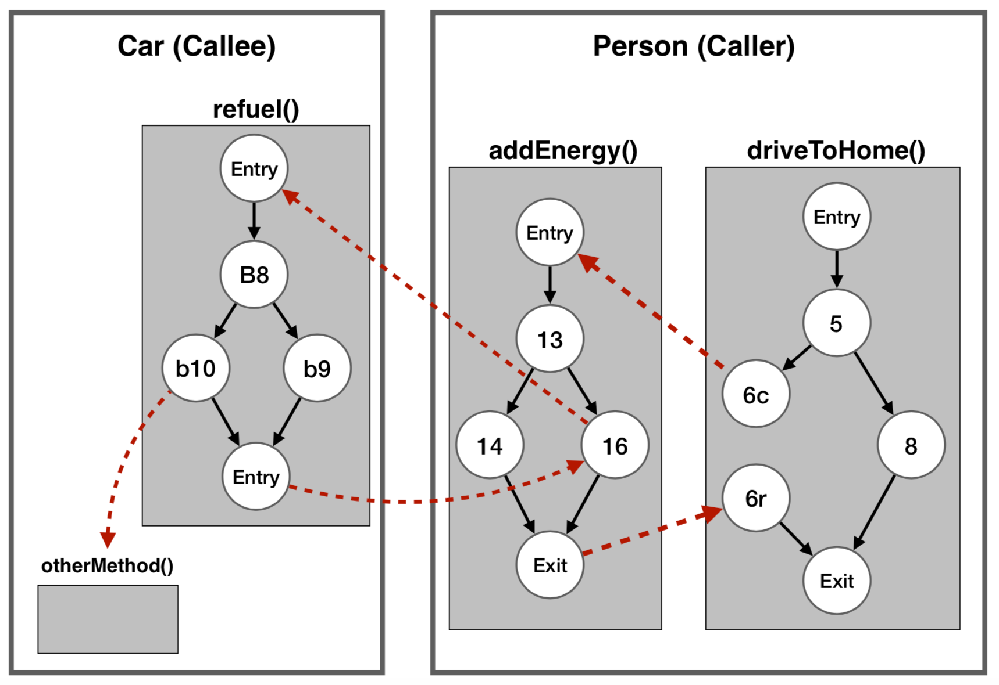


Slide 20
Using call site information
First step towards integration testing
Found 29 bugs that could not be found with EvoSuite (and its evolutions) in 3 projects
Builds on EvoSuite…
Yet, is complementary to EvoSuite generated unit tests

Slide 21
How did we apply T3.4?
How did we apply the things from T3.4 with the use case providers?
ExeComs and Workshops
Visiting partners
Atos
Online calls
Activeeon, Xwiki, OW2, Tellu, Atos, Engineering
GitHub issues for development and support
Tutorial
https://github.com/STAMP-project/evosuite-model-seeding-tutorial
Tracking of results + feedback from partners
https://github.com/STAMP-project/evosuite-model-seeding-usecases-output
Empirical evaluation performed by Activeeon
2 day bootcamp workshop at TU Delft

Slide 22
T3.5
Strategies for speeding-up runtime amplification

Slide 23
Strategies for speeding-up runtime amplification
EvoCrash ➜ Botsing framework
Industry ready, friendly license, easy to extend
Model seeding, preprocessing
RAMP
Extension of EvoSuite for runtime amplification
Model seeding
Botsing optimization
Parallelization of execution of Botsing
T3.1
T3.2
T3.3
T3.4
T3.5

Slide 24
WP3
General WP3 information

Slide 25
Development statistics
 | Botsing |  | RAMP |  | Botsing-parallel
 | 05/18 | 11/19 | 05/18 | 11/19 | 05/18 | 11/19
# commits since last version | 0 | 733 | 0 | 42 | 0 | 26
# changes | 0 | 24,503 insertions 5 deletions | 0 | 4,180 insertions, 1,731 deletions | 0 | 6,316 insertions, 2 deletions
# files | 0 | 253 files changed | 0 | 104 files changed | 0 | 79 files changed
# LOC | 0 | 20,232 | 0 | N.A. | 0 | 438
² Since we extended EvoSuite, it is not possible to accurately report the number of lines of codes. The difference between the last commit after the fork and the HEAD is negative (863,320 LOC - 862,862 LOC).

Slide 26
WP3 interactions with partners
Activeon | Participation in state-of-the-practice logging practices survey Empirical evaluation RAMP/EvoSuite (on site visit TU Delft + online) Scripts for automatic building of projects in benchmark
ENG | Participation in state-of-the-practice logging practices survey Botsing Maven plugin Botsing log preprocessor Botsing parallel Analysis of applicability of distributed genetic algorithms to increase performance
Tellu | Participation in state-of-the-practice logging practices survey Collecting and analyzing stack traces → evaluate Botsing Working with developers to find strategies to replicate crashes Test generation experiments with RAMP

Slide 27
Scientific output
T3.2
A benchmark-based evaluation of search-based crash reproduction, EMSE journal (accepted)
Single-objective Versus Multi-objectivized Optimization for Evolutionary Crash Reproduction, SSBSE’18
Search-Based Crash Reproduction Using Behavioral Model Seeding, STVR journal (minor revision)
Towards Integration-Level Test Case Generation Using Call Site Information, will be submitted to TSE
On The Strength of Multi-objective Optimization for Crash Reproduction, will be submitted to GECCO
Related accepted papers at:
ISSTA’19, EMSE (2x), JSS
T3.3
T3.4
T3.4
T3.3
Pouria Derakhshanfar (PhD estimated 2021) + 5 MSc students
Notes:
* EMSE
Gema Rodríguez-Pérez · Gregorio Robles · Alexander Serebrenik · Andy Zaidman · Daniel M. Germán · Jesus M. Gonzalez-Barahona How Bugs Are Born: A Model to Identify How Bugs Are Introduced in Software Components
Halin, A., Nuttinck, A., Acher, M., Devroey, X., Perrouin, G. and Baudry, B. (2019). Test them all, is it worth it? Assessing configuration sampling on the JHipster Web development stack. Empirical Software Engineering 24, 2 (Apr. 2019),
JSS
Devroey, X., Perrouin, G., Papadakis, M., Legay, A., Schobbens, P.-Y. and Heymans, P. (2018). Model-based mutant equivalence detection using automata language equivalence and simulations. Journal of Systems and Software 141, (Jul. 2018),
ISSTA
Kechagia M., Devroey X., Panichella A., Gousios G., van Deursen A (2019). Effective and Efficient API Misuse Detection via Exception Propagation and Search-based Testing. In 2019 ACM SIGSOFT International Symposium on Software Testing and Analysis (ISSTA).

Slide 28
Tools – functionality & novelty
Botsing
Crash replication modular reimplementation of EvoCrash
Crash replication with seeding novel
Crash replication benchmark (JCrashpack) novel
ExRunner tool for parallel execution of Botsing novel
Bosting-parallel novel
Test case generation using call site information novel
Stack trace preprocessing novel
RAMP
Model+test seeding for test case generation novel

Slide 29
Q&A

